Slide 1
One Divides Into Two
Introduction to Binary Search
Dustin Xu

Slide 2
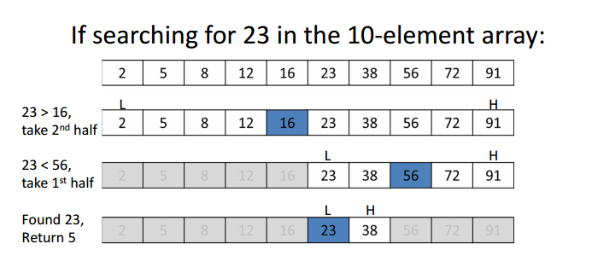
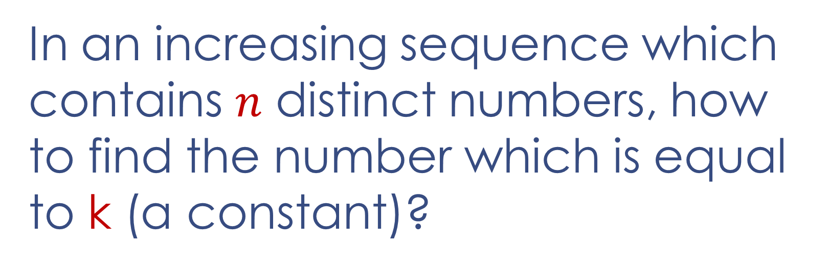
Find the Number
O(log n)
In an increasing sequence which contains $n$ distinct numbers, how to find the number which is equal to k (a constant)?
In fact, this problem is a basic form of binary search. It is very important!

Slide 3
Apple’s Task
Apple wants to test how solid and indestructible iPhone 8 is before the release in late 2017. So they choose a good place to make an experiment. It is on our campus!

Slide 4

Apple wants to test how solid and indestructible iPhone 8 is before the release in late 2017. So they want to make an experiment on our campus!
7
You will be given at most three iPhone 8 as experimental equipment. And you need to tell on and above which floor you cannot drop an iPhone 8 to the ground with no damage to it.
6
5
4
3
2
1

Slide 5
Binary Search
Basically, binary search is used to quickly find a value in a sorted sequence.
Moreover, when a problem is monotonic to some extent (like an increasing sequence), we can divide the search space of the problem into two search spaces and only try to solve the effective one.
Binary search downsizes problem efficiently. Its worst-case time complexity is O(log n).

Slide 6
Quadratic Roots
An Easy Task for You

Slide 7
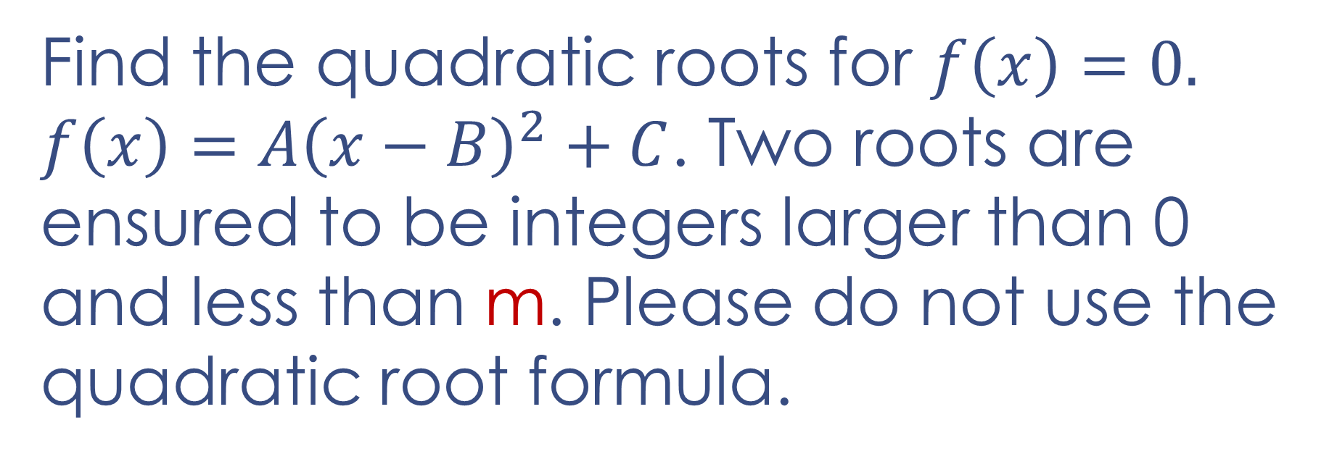
Quadratic Roots
Find the quadratic roots for $f\left(x\right)=0.$
$f\left(x\right)=A{\left(x−B\right)}^{2}+C$. Two roots are ensured to be integers larger than 0 and less than m. Please do not use the quadratic root formula.

Slide 8
A+B=0
An Easy Task for You

Slide 9
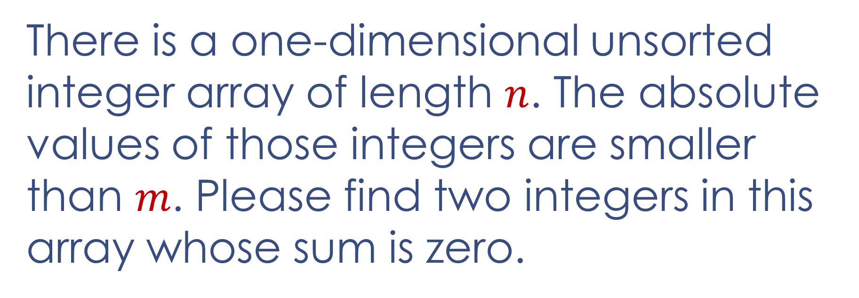
A+B=0
There is a one-dimensional unsorted integer array of length $n$. The absolute values of those integers are smaller than $m$. Please find two integers in this array whose sum is zero.
e.g. -100, 34, 274, 67, 23, -900, -274, -23
You only need to find one pair, for instance (23, -23).

Slide 10
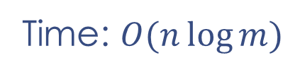
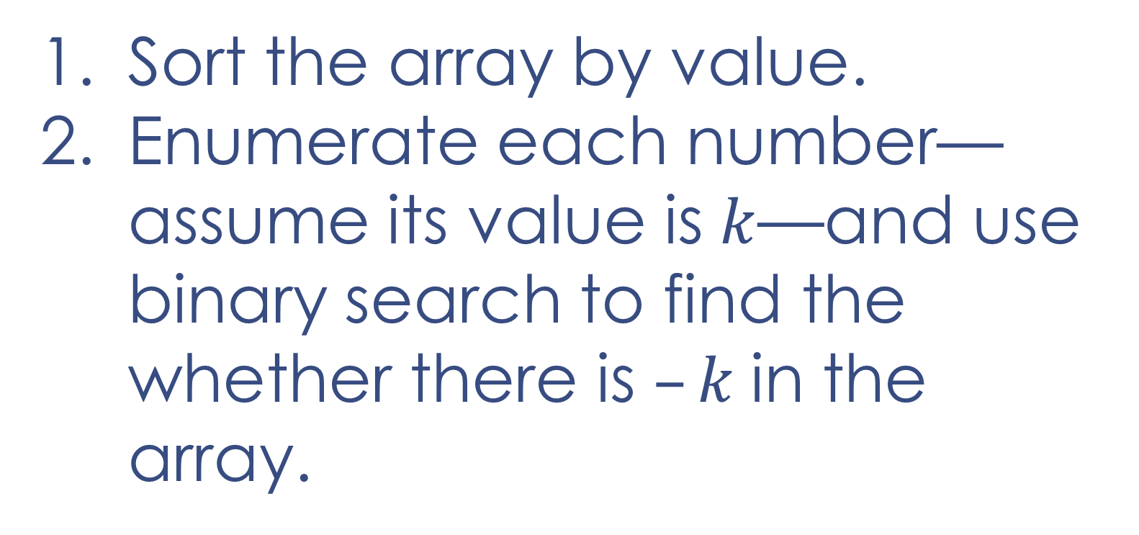
A+B=0
e.g. -100, 34, 274, 67, 23, -900, -274, -23
-900, -274, -100, -23, 23, 34, 67, 274
Sort the array by value.
Enumerate each number—assume its value is $k$—and use binary search to find the whether there is $–k$in the array.
Time: $O(n\log{m})$

Slide 11
Cable Master
An Interesting Task for You

Slide 12
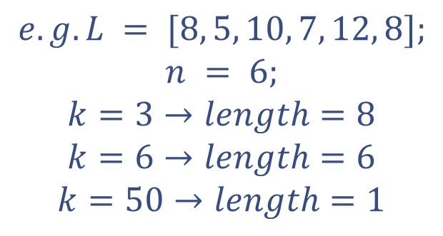
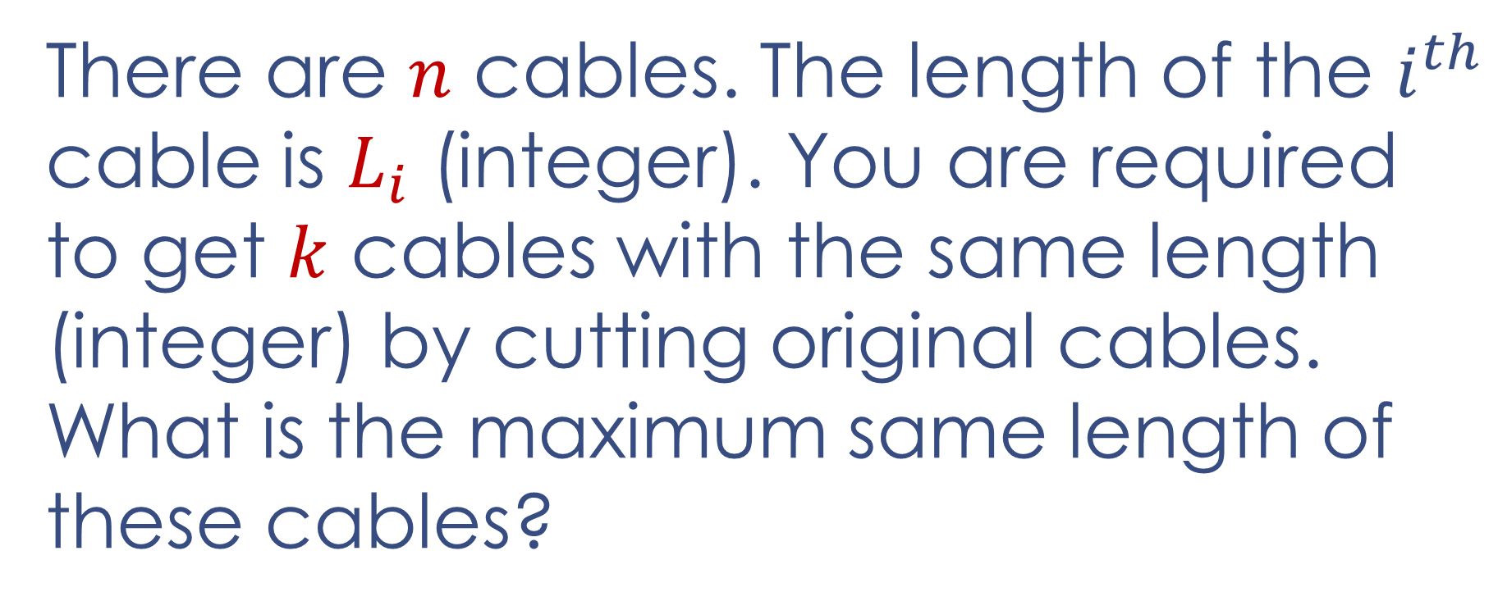
Cable Master
There are $n$ cables. The length of the $i^{th}$ cable is $L_{i}$ (integer). You are required to get $k$ cables with the same length (integer) by cutting original cables. What is the maximum same length of these cables?
$$e.g. L = [8, 5, 10, 7, 12, 8];$$
$$n = 6;$$
$$k=3→length=8$$
$$k=6→length=6$$
$$k=50→length=1$$

Slide 13
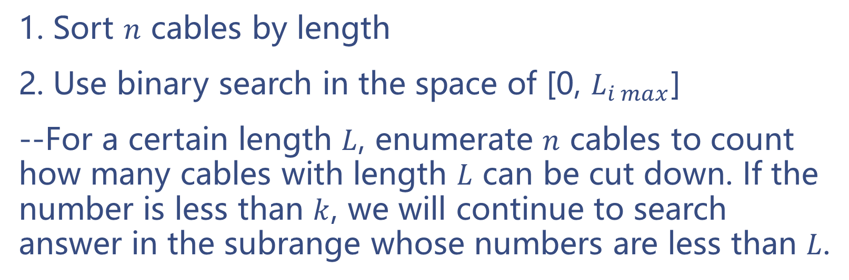
Cable Master
1. Sort $n$ cables by length
2. Use binary search in the space of [0, $L_{i max}$]
--For a certain length $L$, enumerate $n$ cables to count how many cables with length $L$ can be cut down. If the number is less than $k$, we will continue to search answer in the subrange whose numbers are less than $L$.

Slide 14
Aggressive Cows
A More Interesting Task for You

Slide 15
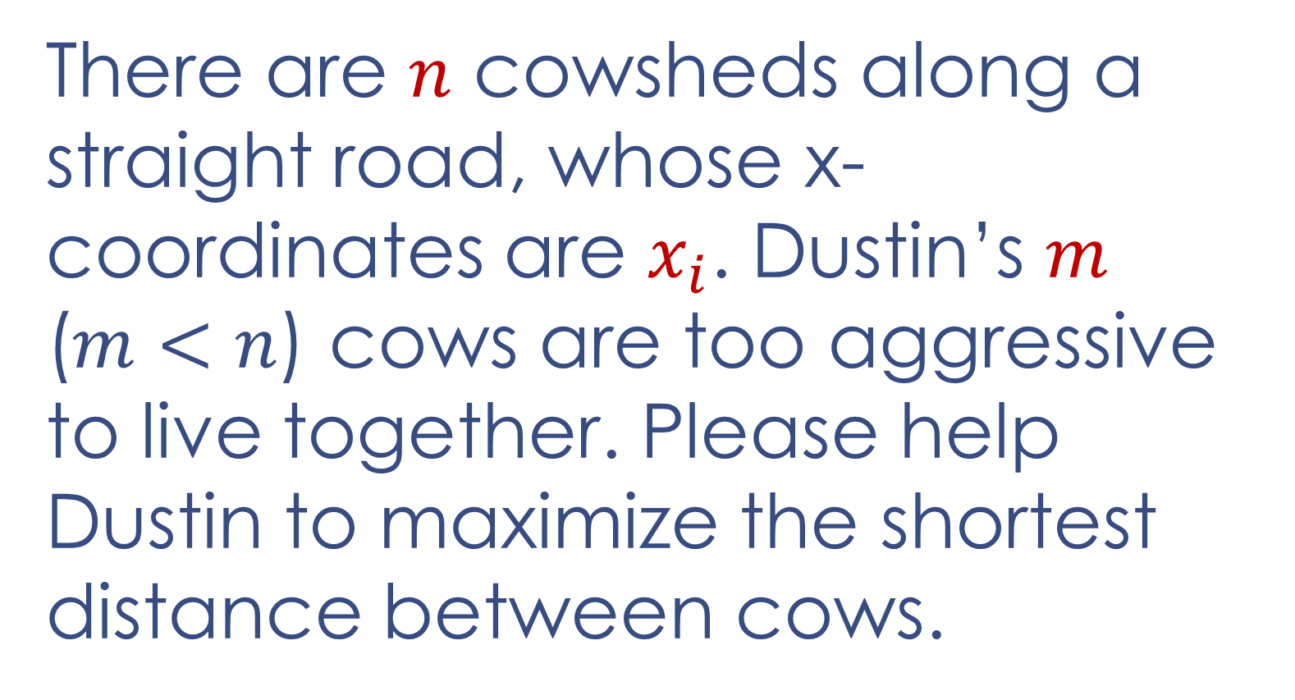
Aggressive Cows
There are $n$ cowsheds along a straight road, whose x-coordinates are $x_{i}$. Dustin’s $m$ ($m<n$) cows are too aggressive to live together. Please help Dustin to maximize the shortest distance between cows.

Slide 16
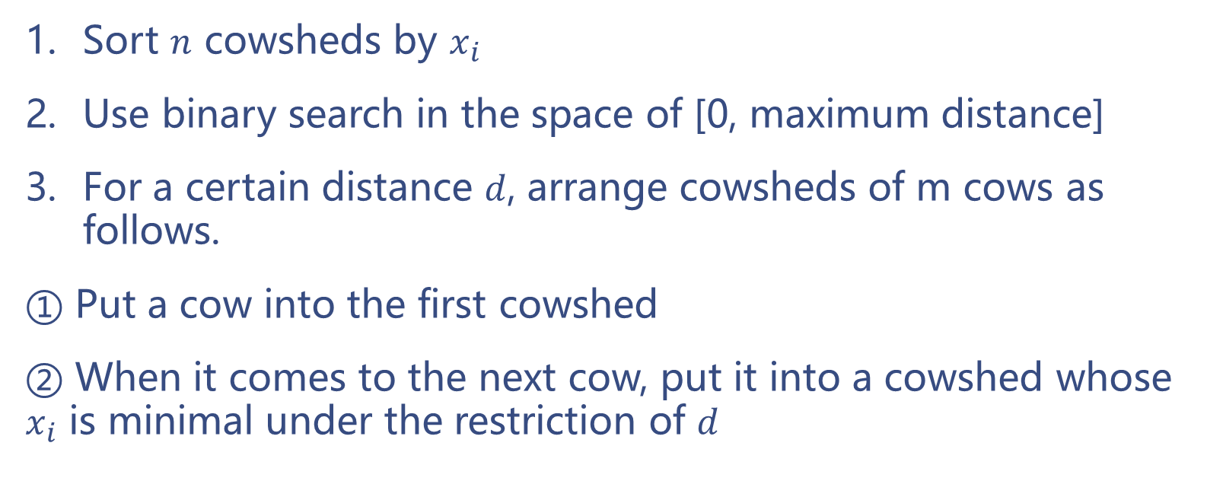
Aggressive Cows
Sort $n$ cowsheds by $x_{i}$
Use binary search in the space of [0, maximum distance]
For a certain distance $d$, arrange cowsheds of m cows as follows.
① Put a cow into the first cowshed
② When it comes to the next cow, put it into a cowshed whose $x_{i}$ is minimal under the restriction of $d$

Slide 17
A+B+C+D=0
A Difficult Task for You

Slide 18
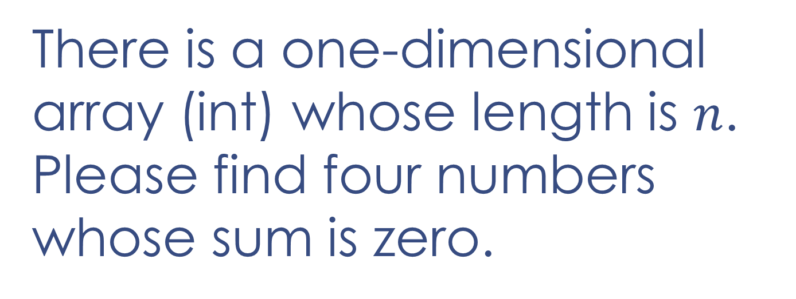
A+B+C+D=0
There is a one-dimensional array (int) whose length is $n$. Please find four numbers whose sum is zero.

Slide 19
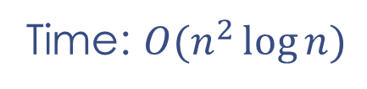
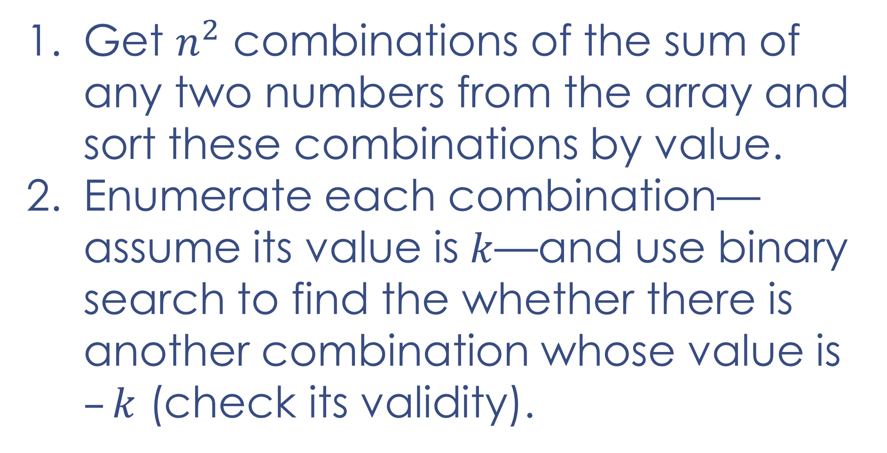
A+B+C+D=0
Time: $O(n^{2}\log{n})$
Get $n^{2}$ combinations of the sum of any two numbers from the array and sort these combinations by value.
Enumerate each combination—assume its value is $k$—and use binary search to find the whether there is another combination whose value is $–k$ (check its validity).

Slide 20
Thank you!

